Slide 1
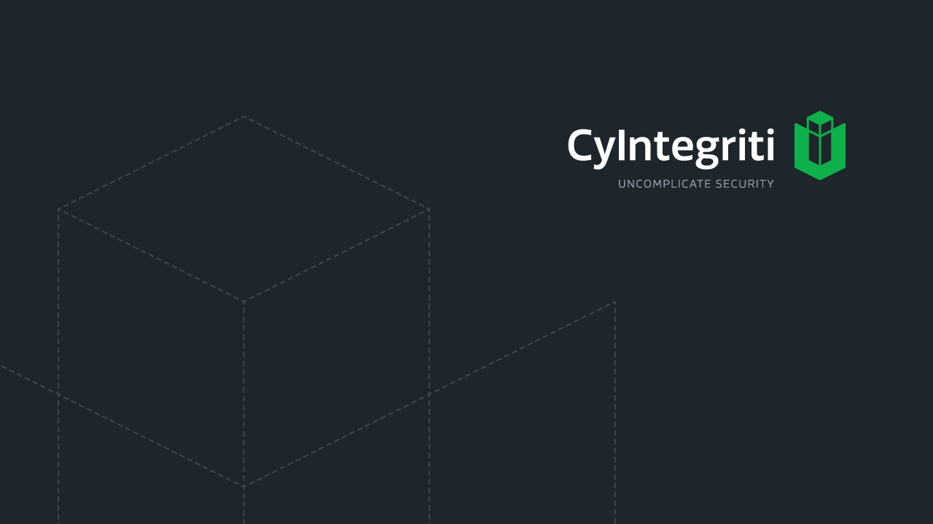
Network Foundations

Slide 2
Network Topology
Manner in which a network is physically connected and shows the layout of resources and systems
Topological structure of a network depicted physically or logically
Types of topology
Ring
Star
Bus
Mesh
Tree
Hybrid
Notes:
How presentation will benefit audience: Adult learners are more interested in a subject if they know how or why it is important to them.
Presenter’s level of expertise in the subject: Briefly state your credentials in this area, or explain why participants should listen to you.

Slide 3
RING Topology
Closed loop unidirectional transmission links to which devices are serially connected
The transmission is unidirectional, but it can be made bidirectional by having 2 connections between each Network Node, it is called Dual Ring Topology
Data is transferred in a sequential manner that is bit by bit. Data transmitted, has to pass through each node of the network, till the destination node.
Advantage
Transmitting network is not affected by high traffic or by adding more nodes, as only the nodes having tokens can transmit data
Cheap to install and expand
Disadvantage
Troubleshooting is difficult in ring topology
Adding or deleting the computers disturbs the network activity
Failure of one computer disturbs the whole network
Notes:
How presentation will benefit audience: Adult learners are more interested in a subject if they know how or why it is important to them.
Presenter’s level of expertise in the subject: Briefly state your credentials in this area, or explain why participants should listen to you.

Slide 4
BUS Topology
Every computer and network device is connected to single cable
When it has exactly two endpoints, then it is called Linear Bus topology.
Single cable with nodes attached
When there are branches from the single cable, it is called Tree topology
It transmits data only in one direction
Every device is connected to a single cable
Advantages
cost effective / easy to understand / Used in small networks.
Easy to expand joining two cables together / Cable required is least compared to other network topology
Disadvantages
Cables fails then whole network fails
If network traffic is heavy or nodes are more the performance of the network decreases.
Cable has a limited length
It is slower than the ring topology
Notes:
How presentation will benefit audience: Adult learners are more interested in a subject if they know how or why it is important to them.
Presenter’s level of expertise in the subject: Briefly state your credentials in this area, or explain why participants should listen to you.

Slide 5
STAR Topology
All the computers are connected to a central node
Every node has its own dedicated connection to the central node
The central node acts as a repeater for data flow
Can be used with twisted pair, Optical Fibre or coaxial cable
Advantages
Fast performance with few nodes and low network traffic
Central nodes can be upgraded easily
Easy to setup, deploy and troubleshoot
Failure of one system does not negatively impact the network
Disadvantages
Cost of installation is high and expensive to use
If central node fails then the whole network is stopped
Performance is based on the central node that is it depends on its capacity
Notes:
How presentation will benefit audience: Adult learners are more interested in a subject if they know how or why it is important to them.
Presenter’s level of expertise in the subject: Briefly state your credentials in this area, or explain why participants should listen to you.

Slide 6
MESH Topology
It is a point-to-point connection to other nodes or devices. All the network nodes are connected to each other.
There are two techniques to transmit data over the Mesh topology, they are :
Routing: the nodes have a routing logic, as per the network requirements
Flooding: the same data is transmitted to all the network nodes, hence no routing logic is required
Partial Mesh Topology : In this topology some of the systems are connected in the same fashion as mesh topology but some devices are only connected to two or three devices.
Full Mesh Topology : Each and every nodes or devices are connected to each other.
Advantages
Each connection can carry its own data load
Provides security and privacy
Disadvantage
Installation and configuration is difficult
Bulk wiring is required
Notes:
How presentation will benefit audience: Adult learners are more interested in a subject if they know how or why it is important to them.
Presenter’s level of expertise in the subject: Briefly state your credentials in this area, or explain why participants should listen to you.

Slide 7
TREE Topology
It has a root node and all other nodes are connected to it forming a hierarchy. It is also called hierarchical topology.
Used in WAN
Ideal if workstations are located in groups
Advantages
Extension of bus and star topologies
Expansion of nodes is possible and easy
Easily managed and maintained
Error detection is easily done
Disadvantages
Heavily cabled
Costly
If more nodes are added maintenance is difficult
Central hub fails, network fails
Notes:
How presentation will benefit audience: Adult learners are more interested in a subject if they know how or why it is important to them.
Presenter’s level of expertise in the subject: Briefly state your credentials in this area, or explain why participants should listen to you.

Slide 8
Media Access Technologies

Slide 9
General Introduction
Deals with how systems communicate over the media
It is usually represented in protocols, NIC drivers and interfaces
They setup the rules
on how systems communicate in a network,
how errors are handled
The MTU – Maximum transmission unit
How much data a frame can carry on a specific network
Some of the Media Access technologies are
Ethernet
Token Ring
FDDI

Slide 10
Token Passing Access method
A token (24-bit control frame) decides which computer can communicate and at what intervals
Only the computer having a token can send data
Other computers have to wait for their turn
Only the computer that sent the data can remove the data from the token and release it; destination computer can only copy the data
Does not have issue with collisions
Token Ring, FDDI protocols use this method

Slide 11
CSMA
Carrier Sense multiple access protocol is used by Ethernet
Two types
CSMA/CD
CSMA/CA
CSMA/CD
Systems monitor the network for transmission activity; if they sense the network to be free; the computer transmits the data
If two systems send the data at the same time, collision occurs
In a network with highly populated network, damaged cable or connector, cables exceeding the recommended value cause too many collisions
If collision happens the devices in the network execute a random collision timer to force a delay before they attempt to transmit data. This timer is called back-off algorithm

Slide 12
CSMA
CSMA/CA
Systems monitor the network for transmission activity; if they sense the network to be free; the computer beacons out a broadcast message before transmitting the data
This is primarily used in Wireless LAN Technology

Slide 13
Collision and Broadcast domain
Collision Domain
Is a group of computers that are contending for the same shared communication medium
Collision domains are there in network that are connected by a hub, repeater or wireless access points
Broadcast Domain
Set of computing nodes that can receive all layer 2 broadcast frames
They are nodes interconnected by switches, bridges or hubs but with no router in between them

Slide 14
Polling
Used by mainframe environments
The systems are divided into primary stations and secondary stations
Primary stations poll the secondary stations at regular intervals to check for any data transmission. This is the only time secondary station can communicate

Slide 15
Ethernet
A set of technologies that enable several devices to communicate on the same network
Usually uses bus or star topology
It is defined by 802.3 Standard
It is contention-based technology
Uses Collision and broadcast domains
Uses CSMA/CD
Supports full duplex communication
Uses coaxial, twisted pair, fibre-optic cabling types

Slide 16
Token Ring
LAN media access technology developed by IBM
Defined by 802.5 standard
Has data transmission rate upto 16Mbps
Uses token passing technology with star-configured topology
Each computer is connected to the central hub MAU (Multiple Access Unit)
Active monitor is used to remove frames that are continuously circulating the network
Beaconing mechanism will ensure if a computer detects a problem it sends a beacon frame
This frame generates a failure domain, which is between the computer that issued the beacon and its neighbour downstream.

Slide 17
FDDI
High speed, token passing media access technology works on Fiber-optic cabling
Has transmission speed upto 100Mbps
Provides fault tolerance by providing a secondary counter-rotating ring
It is primarily used in backbone networks (MAN)
Can be deployed for distances up to 100Kms
Devices fall into the following criteria
Single-attachment station (SAS) – attaches to only one ring through a concentrator
Single-attached concentrator (SAC) – connects a SAS device to the primary ring
Dual-attachment station (DAS) – has two ports, each port provides a connection for both the primary and secondary rings
Dual-attached concentrator (DAC) – concentrator that connects DAS, SAS, and SAC devices to both the rings
FDDI-2 provides fixed bandwidth – makes it work like a broadband connection with QoS capabilities.
Copper Distributed Data Interface (CDDI) – work over UTP and used in LAN environments

Slide 18
Transmission Methods
Unicast – one to one
Broadcast – one to all
Multicast – one to many (Layer 3)
IGMP is used to report multicast group membership to routers
IGMP can be used for online streaming and video activities

Slide 19
Network Protocols and Services

Slide 20

Address Resolution Protocol (ARP)
ARP finds the hardware address, also known as Media Access Control (MAC) address, of a host from its known IP address.
The protocol operates below the network layer as a part of the interface between the OSI network and OSI link layer.

Slide 21
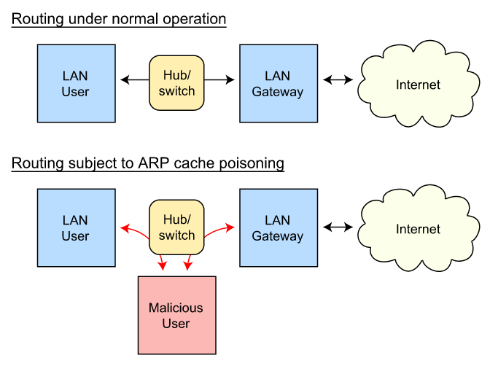
ARP cache poisoning
ARP spoofing, ARP cache poisoning, or ARP poison routing, is a technique by which an attacker sends (spoofed) Address Resolution Protocol (ARP) messages onto a local area network.
The attack can only be used on networks that use the Address Resolution Protocol, and is limited to local network segments
By 0x55534C - Own work, CC BY-SA 3.0, https://commons.wikimedia.org/w/index.php?curid=15034709

Slide 22
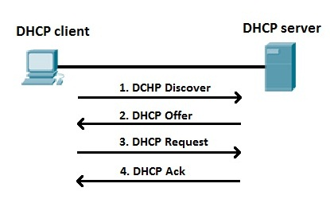
DHCP
Server sends
DHCPACK
Lease is finalized
Client starts using IP
DHCPNAK
Client resumes from DHCPDISCOVER point
If client doesn’t want IP - DHCPDECLINE is sent
DHCPRELEASE gives IP back into pool
Runs over UDP
Utilizing ports:
67 – connections to server
68 – connections to client
Extension of BOOTP (protocol used for simple interaction)
Uses client–server model
All interactions are initiated by a client
Server only replies
Client broadcasts DHCPDISCOVER
One or more servers return DHCPOFFER with available Address and NW Information
Client chooses one offer that it likes best
broadcasts DHCPREQUEST to identify chosen Server/lease
DHCPREQUEST also to renew lease
DHCP Snooping:
Ensures server can allocate IP address only to those systems that are identified by their MAC address

Slide 23
RARP and BOOTP
RARP (Reverse Address Resolution Protocol) is a protocol by which a physical machine in a local area network can request to learn its IP address from a gateway server's Address Resolution Protocol (ARP) table or cache.
An RARP server attached to the physical network normally provides the mapping from a hardware address to an IP address for many hosts
As with ARP requests, RARP requests are sent as hardware (Ethernet) level broadcasts. Thus the server must be present on the same physical network as the diskless workstation
RARP only provides an IP address to a host
BOOTP has been used for Unix-like diskless workstations to obtain the network location of their boot image, in addition to the IP address assignment.
BOOTP was the predecessor of the Dynamic Host Configuration Protocol, successor to RARP
It is still based on a client/server exchange, but is implemented as a higher-layer software protocol, using UDP for message transport. It is not dependent on the particular hardware of the network like RARP.
It supports sending additional configuration information to a client beyond just an IP address. This extra information can usually all be sent in one message for efficiency.
It can handle having the client and server on different networks of an internetwork. This allows the administration of the server providing IP addresses to be more centralized, saving money as well as administrative time and hassle.

Slide 24
ICMP
Internet Control Message Protocol (ICMP) is the component of the TCP/IP protocol stack that addresses this basic limitation of IP.
ICMP does not overcome the unreliability issues in IP.
Reliability must be provided by upper layer protocols if it is needed
ICMP is an error reporting protocol for IP.
When datagram delivery errors occur, ICMP is used to report these errors back to the source of the datagram.
ICMP does not correct the encountered network problem; it merely reports the problem.
ICMP reports on the status of the delivered packet only to the source device.
It does not propagate information about network changes to routers.

Slide 25
SNMP
Client server protocol used to view status of the network, traffic flows, and the hosts within the network
Uses UDP 161 and 162 for communication
Two main components
Manager – server portion, that polls the agent at regular intervals to check status information
Client – software installed in agents, collects information on various parameters of the system (MIB) and share it with the manager when requested for. Clients use trap message to alert Manager when specific parameters changes. That is the only time when a client will respond to manager without polling
Communities are used to create trust between the manager and agent
Two community strings are used
Public – read-only; allows manager to read the data stored in MIB
Private – read-write; allows manager to read and modify the data in MIB
Community strings should be strong
V1 and V2 send community strings in plain text, hence it is important to use V3

Slide 26
DNS
The mechanism by which Internet software translates names to attributes such as addresses
A globally distributed, scalable, reliable database
Comprised of three components
A “name space”
Servers making that name space available
Resolvers (clients) which query the servers about the name space
The name space is the structure of the DNS database
An inverted tree with the root node at the top
Each node has a label
The root node has a null label, written as “”
A domain name is the sequence of labels from a node to the root, separated by dots (“.”s), read left to right
The name space has a maximum depth of 127 levels
Domain names are limited to 255 characters in length
A node’s domain name identifies its position in the name space

Slide 27
Subdomain
One domain is a subdomain of another if its domain name ends in the other’s domain name
So sales.nominum.com is a subdomain of
nominum.com & com
nominum.com is a subdomain of com
nominum.com domain
nominum.com zone
ams.nominum.com zone
rwc.nominum.com zone
Acknowledgement: David Conrad at nominum.com

Slide 28
Name Servers
Name servers store information about the name space in units called “zones”
The name servers that load a complete zone are said to “have authority for” or “be authoritative for” the zone
Usually, more than one name server are authoritative for the same zone
This ensures redundancy and spreads the load
Also, a single name server may be authoritative for many zones
128.8.10.5 serves data for both nominum.com and isc.org zones
Name Servers
Zones
128.8.10.5
nominum.com
202.12.28.129 serves data for nominum.com zone only
202.12.28.129
isc.org
204.152.187.11 serves data for isc.org zone only
204.152.187.11
Acknowledgement: David Conrad at nominum.com

Slide 29
Name Servers
Two main types of servers
Authoritative – maintains the data
Master – where the data is edited
Slave – where data is replicated to
Caching – stores data obtained from an authoritative server
You can think of a name server as part of:
database server, answering queries about the parts of the name space it knows about (i.e., is authoritative for),
cache, temporarily storing data it learns from other name servers, and
agent, helping resolvers and other name servers find data

Slide 30
Name Resolution
A DNS query has three parameters:
A domain name (e.g., www.nominum.com),
Remember, every node has a domain name!
A class (e.g., IN), and
A type (e.g., A)
Upon receiving a query from a resolver, a name server
1) looks for the answer in its authoritative data and its cache
2) If step 1 fails, the answer must be looked up

Slide 31
The Resolution Process
Let’s look at the resolution process step-by-step:
annie.west.sprockets.com
ping www.nominum.com.
Acknowledgement: David Conrad at nominum.com

Slide 32
The Resolution Process
The workstation annie asks its configured name server, dakota, for www.nominum.com’s address
dakota.west.sprockets.com
What’s the IP address of www.nominum.com?
annie.west.sprockets.com
ping www.nominum.com.
Acknowledgement: David Conrad at nominum.com

Slide 33
The Resolution Process
The name server dakota asks a root name server, m, for www.nominum.com’s address
m.root-servers.net
dakota.west.sprockets.com
What’s the IP address of www.nominum.com?
annie.west.sprockets.com
ping www.nominum.com.
Acknowledgement: David Conrad at nominum.com

Slide 34
The Resolution Process
The root server m refers dakota to the com name servers
This type of response is called a “referral”
m.root-servers.net
dakota.west.sprockets.com
Here’s a list of the com name servers. Ask one of them.
annie.west.sprockets.com
ping www.nominum.com.
Acknowledgement: David Conrad at nominum.com

Slide 35
The Resolution Process
The name server dakota asks a com name server, f, for www.nominum.com’s address
What’s the IP address of www.nominum.com?
m.root-servers.net
dakota.west.sprockets.com
f.gtld-servers.net
annie.west.sprockets.com
ping www.nominum.com.
Acknowledgement: David Conrad at nominum.com

Slide 36
The Resolution Process
The com name server f refers dakota to the nominum.com name servers
Here’s a list of the nominum.com name servers. Ask one of them.
m.root-servers.net
dakota.west.sprockets.com
f.gtld-servers.net
annie.west.sprockets.com
ping www.nominum.com.
Acknowledgement: David Conrad at nominum.com

Slide 37
The Resolution Process
The name server dakota asks a nominum.com name server, ns1.sanjose, for www.nominum.com’s address
What’s the IP address of www.nominum.com?
m.root-servers.net
dakota.west.sprockets.com
ns1.sanjose.nominum.net
f.gtld-servers.net
annie.west.sprockets.com
ping www.nominum.com.
Acknowledgement: David Conrad at nominum.com

Slide 38
The Resolution Process
The nominum.com name server ns1.sanjose responds with www.nominum.com’s address
m.root-servers.net
dakota.west.sprockets.com
Here’s the IP address for www.nominum.com
ns1.sanjose.nominum.net
f.gtld-servers.net
annie.west.sprockets.com
ping www.nominum.com.
Acknowledgement: David Conrad at nominum.com

Slide 39
The Resolution Process
The name server dakota responds to annie with www.nominum.com’s address
Here’s the IP address for www.nominum.com
m.root-servers.net
dakota.west.sprockets.com
ns1.sanjose.nominum.net
f.gtld-servers.net
annie.west.sprockets.com
ping www.nominum.com.
Acknowledgement: David Conrad at nominum.com

Slide 40
Resolution Process (Caching)
After the previous query, the name server dakota now knows:
The names and IP addresses of the com name servers
The names and IP addresses of the nominum.com name servers
The IP address of www.nominum.com
Let’s look at the resolution process again
annie.west.sprockets.com
ping ftp.nominum.com.
Acknowledgement: David Conrad at nominum.com

Slide 41
Resolution Process (Caching)
The workstation annie asks its configured name server, dakota, for ftp.nominum.com’s address
m.root-servers.net
dakota.west.sprockets.com
What’s the IP address of ftp.nominum.com?
ns1.sanjose.nominum.net
f.gtld-servers.net
annie.west.sprockets.com
ping ftp.nominum.com.
Acknowledgement: David Conrad at nominum.com

Slide 42
Resolution Process (Caching)
dakota has cached a NS record indicating ns1.sanjose is an nominum.com name server, so it asks it for ftp.nominum.com’s address
What’s the IP address of ftp.nominum.com?
m.root-servers.net
dakota.west.sprockets.com
ns1.sanjose.nominum.net
f.gtld-servers.net
annie.west.sprockets.com
ping ftp.nominum.com.
Acknowledgement: David Conrad at nominum.com

Slide 43
Resolution Process (Caching)
The nominum.com name server ns1.sanjose responds with ftp.nominum.com’s address
m.root-servers.net
dakota.west.sprockets.com
Here’s the IP address for ftp.nominum.com
ns1.sanjose.nominum.net
f.gtld-servers.net
annie.west.sprockets.com
ping ftp.nominum.com.
Acknowledgement: David Conrad at nominum.com

Slide 44
Resolution Process (Caching)
The name server dakota responds to annie with ftp.nominum.com’s address
Here’s the IP address for ftp.nominum.com
m.root-servers.net
dakota.west.sprockets.com
ns1.sanjose.nominum.net
f.gtld-servers.net
annie.west.sprockets.com
ping ftp.nominum.com.
Acknowledgement: David Conrad at nominum.com

Slide 45
DNS Attacks
DNS cache poisoning
These attacks capture and divert queries to another website unknown to users
Denial of service (DoS)
Attempts to make a given service impossible or very hard to access. Attacks sometimes use brute force (saturating servers by flooding them with simultaneous queries) or go for a more subtle approach by exhausting a rare resource on the server
Distributed denial of service (DDoS)
An elaborate form of DoS that involve thousands of computers generally as part of a botnet or robot network: a network of zombie computers that the attacker commandeers from their unwitting owners by spreading malware from one machine to another
Reflected attacks
send thousands of requests with the victim’s name as the source address. When recipients answer, all replies converge on the official sender, whose infrastructures are then affected.

Slide 46
DNS Attacks
Reflective amplification DoS:
if the size of the answer is larger than the question, an amplification effect is caused. The same technique as reflected attacks is used, except that the difference in weight between the answer and question amplifies the extent of the attack. A variant can exploit the protective measures in place, which need time to decode the long replies; this may slow down query resolution
Cybersquatting
involves registering a domain name with the deliberate intent of undermining and profiting from a third party’s rights or in some way harming that third party.
"Name-jacking" or theft
appropriating the domain name (updating the holder’s field and/or contacts) or taking control by technical means to divert traffic, such as by modifying the name servers hosting the site.

Slide 47
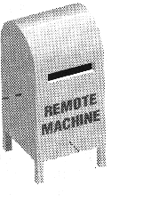
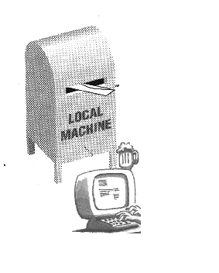

SMTP
SMTP clients and servers have two main components
User Agents – Prepares the message, encloses it in an envelope. (ex. Thunderbird, Eudora)
Mail Transfer Agent – Transfers the mail across the internet (ex. Sendmail, Exim)
POP vs. IMAP
POP3:
All Messages
Internet
Whole message
IMAP:
Dr.Amer
Friends
….
Internet
headers

Slide 48
Post Office Protocol v3
Simple
Allows the user to obtain a list of their Emails
Users can retrieve their emails
Users can either delete or keep the email on their system
Minimizes server resources

Slide 49
Internet Mail Access Protocol v4
Has more features than POP3
User can check the email header before downloading
Emails can be accessed from any location
Can search the email for a specific string of characters before downloading
User can download parts of an email
User can create, delete, or rename mailboxes on a server

Slide 50
Email Threats
Email Spoofing
Modifying the fields in the email header so that the email appears to be from a trusted source
Controls
SMTP-AUTH
The AUTH command is an ESMTP command (SMTP service extension) that is used to authenticate the client to the server. The AUTH command sends the clients username and password to the e-mail server.
Sender Policy Framework (SPF)
Allows administrators to specify which hosts are allowed to send emails from a given domain. This is done by creating a SPF record in DNS
Phishing Attack
Spear Phishing
Targets a particular set of population
Whaling attack
Target high profile individuals

Slide 51
Network Address translation
NAT is a gateway between Internal private network and Internet that performs transparent routing and address translation
3 Basic types of NAT implementation
Static NAT
Each Private IP is fixed a public IP address
Primarily done for Public facing servers and devices that interact with non-IP protocols
Dynamic NAT
A pool of IP is reserved for Translation
Private IP connecting to Internet use one IP from the pool on a first-come first-serve basis
Port address translation (PAT)
One IP is used to NAT a group of private IPs

Slide 52
Routing Protocols
Autonomous Systems
An autonomous system (AS) is a portion of the internetwork under the same administrative authority.
A unique ASN is allocated to each AS for use in BGP routing.
Routing Protocols
Routing protocols were created for routers. These protocols have been designed to allow the exchange of routing tables, or known networks, between routers
The two main types of routing: Static routing and Dynamic routing
Dynamic Routing Protocol
Dynamically discover and maintain routes
Calculate routes, Distribute routing updates to other routers
Reach agreement with other routers about the network topology
Static Routing Protocol
Statically programmed routers send data over routes defined by the network Administrator.
Route Flapping
Occurs when a router alternately advertises a destination network via one route then another (or as unavailable, and then available again) in quick sequence.
Blackhole
A null route (blackhole route) is a network route (routing table entry) that goes nowhere.

Slide 53
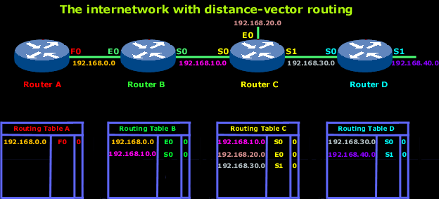
Dynamic Routing Protocols – Distance Vector
Routes are advertised as vectors of (distance, direction), where distance is defined in terms of a metric and direction is defined in terms of the next-hop router.
each router learns routes from its neighbouring routers' perspectives and then advertises the routes from its own perspective.
Distance vector routing is sometimes referred to as "routing by rumor.“
Distance vector routing protocols include the following:
Routing Information Protocol (RIP) for IP
Xerox Networking System's XNS RIP
Novell's IPX RIP
Cisco's Internet Gateway Routing Protocol (IGRP)
AppleTalk's Routing Table Maintenance Protocol (RTMP)

Slide 54
Link State Routing Protocol
The basic concept of link-state routing is that every node constructs a map of the connectivity to the network, in the form of a graph, showing which nodes are connected to which other nodes.
Each router in the network keeps a copy of it, without changing it. After obtaining the complete picture of network topology, each router will independently calculate its own best paths to reach the destination networks.
Link state protocols are based on Shortest Path First (SPF) algorithm to find the best path to a destination.
Shortest Path First (SPF) algorithm is also known as Dijkstra algorithm.
Whenever a link's state changes, a routing update called a Link-State Advertisement (LSA) is exchanged between routers
When a router receives an LSA routing update, the link-state algorithm is used to recalculate the shortest path to affected destinations.
Examples of link state routing protocols are:
Open Shortest Path First (OSPF) for IP
Novell's NetWare Link Services Protocol (NLSP)

Slide 55
Distance Vector Vs Link State
Distance Vector | Link State
Distance Vector router tells ONLY neighbours about ALL routes | Link-State router tells ALL other routers about ONLY its neighbors and links
With Distance Vector protocols a router can't send out new vectors until it has processed them | In Link-State protocols Update and Decision processes are independent
 | Displays faster convergence than distance vector routing protocols
 | More scalable due to hierarchical nature
 | Require more memory to store state information

Slide 56
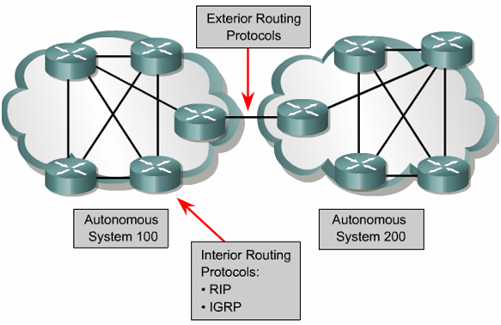
Interior vs Exterior Routing Protocols

Slide 57
Interior Routing Protocols
Routing Information Protocol
It is a distance vector protocol
Considered a legacy protocol (slow performance and lack of functionality)
Should be used only within small networks
V1 has no authentication
V2 sends passwords in clear text or MD5 Hashed
V3 supports IPV6

Slide 58
Interior Routing Protocols
Open Shortest Path First (OSPF)
It is a Link state protocol
Uses LSA to send out routing table information
Provides more stable network than RIP
Requires more memory and CPU resources
Allows for hierarchical routing network
OSPF V3 uses IPSec for authentication

Slide 59
Interior Routing Protocols
Interior Gateway Routing Protocol (IGRP)
It is a Distance Vector protocol
Cisco Proprietary
IGRP is intended for use in gateways connecting several networks.
The metrics used by IGRP include the following:
Topological delay time - the amount of time it would take to get to the destination along that pat
Narrowest bandwidth segment of the path - the bandwidth in bits per second of the slowest link in the path.
Channel occupancy of the path - indicates how much of that bandwidth is currently in use
Reliability of the path - It is the fraction of packets that arrive at the destination undamaged.

Slide 60
Interior Routing Protocols
Enhanced Interior Gateway Routing Protocol (EIGRP)
Cisco-proprietary Hybrid routing protocol, incorporating features of both Distance-Vector and Link-State routing protocols.
EIGRP will form neighbour relationships with adjacent routers in the same Autonomous System (AS).
EIGRP traffic is either sent as unicasts, or as multicasts on address 224.0.0.10, depending on the EIGRP packet type.
EIGRP routers do not send periodic, full-table routing updates. Updates are sent when a change occurs, and include only the change.
EIGRP supports IP, IPX, and Appletalk routing.

Slide 61
Interior Routing Protocols
Virtual Router Redundancy Protocol (VRRP)
Used in networks that cannot tolerate router single point of failure
Used in router HA
Designed to increase the availability of the default gateway
A virtual router is advertised as default gateway and two routers are mapped to the virtual router, acting as redundant pairs
Intermediate System to Intermediate System (IS-IS)
Link State protocol
Similar to OSPF builds database of network topology
Vendor neutral classless and hierarchical routing protocol
Does not support IP address

Slide 62
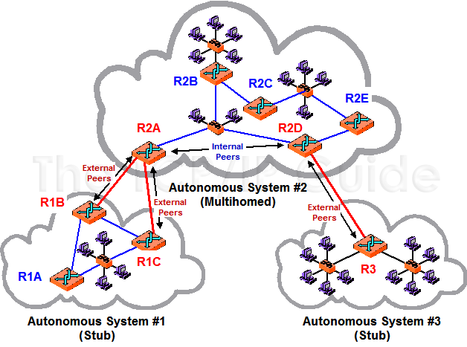
Exterior Routing Protocol
Exterior Gateway Protocols handle routing outside an Autonomous System
Border Gateway Protocol (BGP) is a routing protocol used to transfer data and information between different host gateways, the Internet or autonomous systems.
BGP is a Path Vector Protocol (PVP), which maintains paths to different hosts, networks and gateway routers and determines the routing decision based on that.
It uses both Link state and Distance vector routing routing algorithms
Creates a network topology using Link state functionality
Propagates the updates a periodic intervals similar to Distance Vector routing

Slide 63
Networking Devices

Slide 64
Repeaters
Works at the physical layer
Does not understand IP or MAC address
Helps extend the network connections by extending the signals between cable segments
Helps amplify signals
Works best for Digital signals than analog signals
Hub is a multi-port repeater
Broadcasts packets to all ports

Slide 65
Bridges
Works at the Datalink layer (MAC address)
Works with frames
Helps amplify signals
Segments a large network into smaller networks
3 main type of bridges
Local: Connects two LAN segments with a local area
Remote: Connects two LAN segments over a MAN
Translation: Connects two LAN segments using different types and standards
Broadcast Storm:
Bridges can forward broadcast traffic causing a network or broadcast storm

Slide 66
Transparent Bridging
A bridge that observes incoming network traffic to identify media access control (MAC) addresses.
Transparent bridge records MAC addresses in a table that is much like a routing table and evaluates that information whenever a packet is routed toward its location.
The algorithm has five parts:
Learning
Flooding
Filtering
Forwarding
Avoiding loops

Slide 67
Spanning Tree Algorithm
Spanning Tree Protocol (STP) is a Layer 2 protocol that runs on bridges and switches.
Implemented on bridges and switches in order to prevent loops in the network
The algorithm is responsible for a bridge using only the most efficient path when faced with multiple paths.
The spanning tree algorithm determines the network (which computer hosts are in which segment) and this data is exchanged using Bridge Protocol Data Units (BPDUs).

Slide 68
Source Routing
Technique whereby the sender of a packet can specify the route that a packet should take through the network.
It is assumed that the source of the packet knows about the layout of the network and can specify the best path for the packet
A common form of source routing is called loose source record route (LSRR). When using LSRR the sender will provide one or more hops that the packet must go through.
This is dangerous because it allows the sender to bypass control points.

Slide 69
Switch
Combines the functionality of the repeater and bridge
It’s a multiport bridge
Works at Layer 2, but there are switches that can work upto Layer 4
Prevents collision domains and reduces broadcast
Switches that work at layers beyond 2 are called as multi-layered switches
They use hardware-based processing power to offer routing functionality, packet inspection, QoS etc.

Slide 70
Switch – Tags/Label (MPLS)
Layer 3 and 4 Switches use a concept called tags to route traffic
Tags are assigned to each network or subnet and the information is stored in the switches
When a packet reaches the first switch, the destination is verified and the tag is mapped
From now on, every other switch will just look at the tag and route the traffic instead of analysing the complete header information
This ensures efficient routing and also helps in setting labels for different priority data

Slide 71
VLAN
A VLAN is a group of devices on one or more LANs that are configured to communicate as if they were attached to the same wire
VLAN controls the broadcast without the use of layer 3 devices.
Switch ports are operate in 2 different modes; Access and Trunks.
Access ports: are those which carry the traffic of only one VLAN.
Trunk ports: It carries multiple VLANs at a time. Unlike access ports when the switch forwards a frame out the trunk interface it adds VLAN tagging information.

Slide 72
VLAN Hopping Attacks
The basic concept behind all VLAN hopping attacks is for an attacking host on a VLAN to gain access to traffic on other VLANs that would normally not be accessible.
There are two primary methods of VLAN hopping: switch spoofing and double tagging
Switch spoofing: An attacking host imitates a trunking switch by speaking the tagging and trunking protocols used in maintaining a VLAN. Switch spoofing can only be exploited when interfaces are set to negotiate a trunk.
Double tagging attack: A double tagging attack begins when an attacker sends a frame connected to a switch port using two VLAN tags in the frame header. If the attacker is connected to an 802.1Q trunk port, the first tag matches that of the native VLAN (usually 1). The second tag identifies the VLAN the attacker would like to forward the frame to.

Slide 73
Router
Layer 3 device
Works with packets
Helps interconnect different segments, network or VLANs
Controls broadcast as well as collision domains
Controls access between segments via ACLs
Performs Address Translation

Slide 74
Gateway
Gateways regulate traffic between two dissimilar networks, while routers regulate traffic between similar networks
Gateways perform more complex functions than the router
Eg: connect voice and data network; connect IPX with IP network

Slide 75
Firewalls
Used to restrict access to one network from another network
Considered chock points in the network
Work from Layer 3 to Layer 7
Different types
Packet filtering
Stateful
Proxy
Dynamic Packet filtering
Kernel Proxy
3 different firewall architectures
Screened host
Multihomed
Screened subnet

Slide 76
Packet Filtering Firewall
Works in Layer 3 and 4
Stateless firewalls
Takes decision based on source and destination IP/Port numbers, protocol type and direction
Advantage | Disadvantage
Not application dependent | Cannot prevent attacks that attack application specific vulnerabilities
Scalable | Has limited logging facilities
Have high performance | Do not support identity based access
Commonly used as first line of defence | Cannot detect spoofed address
 | May not be able to detect fragmentation attacks

Slide 77
Stateful firewalls
Maintains a state table of all connections; only the first packet is deep inspected, subsequent connections are not inspected
Provides high degree of security and does not introduce the performance hit
It is scalable and transparent to the user
Provides data for tracking connectionless protocols

Slide 78
Proxy Firewalls
Intercepts and inspects the packets before it is delivered to the destination
It breaks the connection between the peers
Two types of proxies
Circuit Level Proxy
Application Layer Proxy

Slide 79
Circuit-level Vs Application Layer Proxy
Circuit-level Proxy | Application Layer Proxy
Works at the session layer | Works at the application layer
Cannot look into the contents of the packet | Has visibility to the entire packet
Takes decision based on the header information | Takes decision based on the content of the packet
It is application independent | Has one proxy per protocol
SOCKS is a circuit level proxy | Capable of authenticating users directly
 | Has performance issues due to deep inspection

Slide 80
Dynamic Packet Filtering
Helps in creating dynamic ACLs for connections initiated from internal networks
Return traffic is allowed based on the dynamic source port combinations
Helps prevent creating multiple ACLs in the firewall

Slide 81
Kernel Proxy firewalls
5th generation firewall
It creates dynamic, customized network stacks when a packet needs to be evaluated
The packet is scrutinized at every layer of the protocol stack and action is determined
It breaks the connection between the peers (proxy)
Faster than application proxy firewalls
Can perform NAT functionality

Slide 82
Firewall Architecture
Dual-Homed Firewall:
A device that has two interfaces connecting to two different segments, controlling traffic flow
The device should not perform packet forwarding and routing functionalities
Screened Host:
A device that is connected to the Internet router; segregating the Internal network
Traffic from the Internet router can only connect to this firewall; after inspection it is passed on to the internal network
Screened Subnet:
Adds another layer of protection to the screened-host architecture
Instead of routing traffic from the internet after screened host firewall, the connection passes through another firewall
This creates DMZ segment in the network
Provides multiple layer protection

Slide 83
Firewall best Practices
Silent Rule: Drop noisy traffic without logging
Stealth Rule: Frist rule, block connections targeting the firewall
Cleanup Rule: Last rule, drops and logs all traffic that does not meet the preceding rules
Negate Rule: provide access only to the required needs.

Slide 84
Proxy Servers
Acts as intermediary between clients that need to communicate
Caches the responses it receives so that requests from other clients are served faster
Forwarding proxy: Forwards connections from the clients to the intended destinations; helps perform URL filtering, malware protection, data loss prevention
Reverse Proxy: Acts as intended servers the clients try to connect to; can perform load balancing, encryption, caching

Slide 85
Honeypot
A computer that is intended to be exploited by attacker
Usually sits in the screened subnet
Should not be directly connected or be a jump host to internal network
Helps understand the strategies targeted by the attacker
Two or more honeypots combined together to form Honeynet
Tarpit is a type of honeypot that provides protection against automated scanners by delaying the responses to be timed-out

Slide 86

Karthikeyan Dhayalan
MD & Chief Security Partner
www.cyintegriti.com

